Slide 1
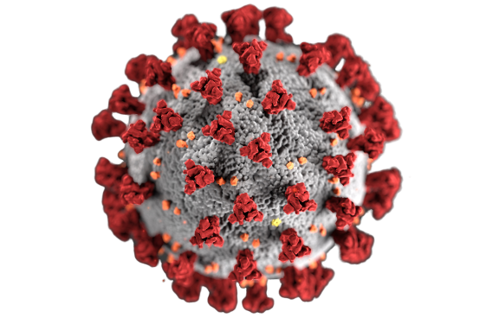
SIX PRONGED APPROACH
SENIOR CITIZENS
NON MEDICAL
HELP LINE
Sewa International, USA
SIX PRONGED APPROACH
INTERNATIONAL STUDENTS
MEDICAL SUPPLIES
COVID-19 Pandemic
Sewa Relief Work Expands
CASE MANAGEMENT
FOOD & GROCERIES

Slide 2
3,000+
VOLUNTEERS ENGAGED
IN COVID-19 RELIEF
10
non medical
help LINE CENTERS
$100,000+
DONATED TO
FOOD PANTRIES
1000+
OrganizatiONS
REACHED THROUGH PLEDGE FOR SERVICE CAMPAIGN
$1,000,000+
RaiSED FOR COVID-19
RELIEF EFFORTS
625,000+
N95, KN95, SURGICAL
MASKS DISTRIBUTED
63,000+
hOT MEALS
& FOOD KITS
45,000+
FAMILIES SERVED (FOOD/GROCERY)
200+
PhysiciANS
& ATTORNEYS
TOGETHER WE SERVE BETTER...

Slide 3
75+
PLASMA DONORS
OrganizatiONS
30 RECIPIENTS, 4 PATIENTS SERVED VIA ONLINE PLASMA REGISTRY
43
CHAPTERS
Engaged iN COVID 19 RELIEF WORK ACROSS UNITED STATES
1000+
Volunteers
MakiNG HOMEMADE
PROTECTIVE MASKS
90
WebINARS
CONDUCTED ON HEALTH
& VISA ISSUES
45
NEIGHBORHOOD SEWA
initiated iN USA FOR ENGAGING VOLUNTEERS
300+
INTernatIONAL STUDENTS
SUPPORTED ACCOMMODATION, FOOD/GROCERY, TRAVEL, ETC.
110K+
VIEWERS REACHED THROUGH
SOCIAL MEDIA

Slide 4
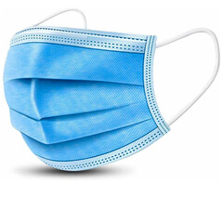
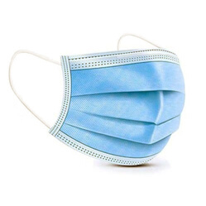
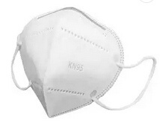
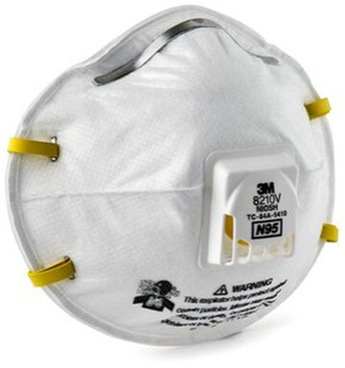
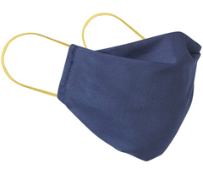
5000+ HAIR BONNETS
2500+ PAIRS OF GLOVES
50+ PULSE
THERMOMETER
25,000+
4 PLY FACE MASK DISTRIBUTED
500+ FACE SHIELDS
420,000+
3 PLY FACE MASK DISTRIBUTED
70,000+
KN95 MASK
DISTRIBUTED
200+ IR
THERMOMETER
50+ OXIMETERS
100 LTS+ DISINFECTION/
LYSOL
80,000+
HOME MADE MASK
DISTRIBUTED
1000+PROTECTIVE
GOGGLES
30,000+
N95 MASK
DISTRIBUTED
300+ GALLONS HAND
SANITIZER
2000+ SHOE COVERS

Slide 5
ENDORSEMENTS BY PROMINENT PEOPLE FOR SEWA INTERNATIONAL WORK
SRI SRI GANAPATHY
SACHCHIDANANDA SWAMIJI AVADHOOTA DATTA PEETHAM, MYSURU
SHANTANU MUKHERJEE
INDIAN PLAYBACK
SINGER
RAHUL SOLAPURKAR
INDIAN FILM
ACTOR
PADMA SHRI PADMAJA
PHENANY JOGLEKAR
HINDUSTANI CLASSICAL SINGER
PUJYA CHAITANYAMURTIDAS SWAMI
BAPS SWAMINARAYAN SANSTHA
PADMA SHRI
DR. SHUDHIR PARIKH
SHREE SWAMINARAYAN
GURUKUL
SHREE SHANTIPRIYDAS SWAMI
UDAY TIKEKAR
INDIAN FILM ACTOR
HH SRI SIDDHESWARANANDA
BHARATI SRI SIDDHESWARI
PEETHAM OF COURTALLAM
DR SWATI KULKARNI
CONSUL GENERAL OF INDIA ATLANTA
DR. JAGDISH SHETH
GOIZUETA BUSINESS SCHOOL OF EMORY UNIVERSITY
UPENDRA CHIVUKULA
FORMER ASSEMBLYMAN
NEW JERSEY
SHREE SWAMINARAYAN SATSANG MANDAL VADATAL DHAM NJ,
SANDEEP CHAKRAVORTHY CONSUL GENERAL NEW YORK
SRI SASHIBHUSHAN MOCHERLA
PRESIDENT
SRI SIDDHESWARI SEVA
SWAMI
PARIPOORNANANDA
SRI PEETHAM, KAKINADA
PROF. VED PRAKASH NANDA
PADMA BHUSHAN
AWARDEE
SHOUNAK ABHISHEK
IINDIAN VOCALIST
GURUDEV SRI SRI RAVI SHANKAR
SPIRITUAL LEADER
KAILASH KHER
INDIAN SINGER
SADHVI BHAGAWATI SARASWATIJI, PHD
PARMARTH NIKETAN ASHRAM
VIDYA JOSHI
BRUHAN MAHARASHTRA MANDAL OF NORTH AMERICA

Slide 6
TOGETHER WE SERVE BETTER
Donate with Confidence
sewausa.org/donate
……………………………………………………………………………………………………………………………………………………………………………………………………………………..
THE WORLD
NEEDS
US
ONLINE
DONATION
WIRE
TRANSFER
PAY
PAL
DONATION
BY CHECK
ZELLE
PAY
TO FIGHT AGAINST
WWW.SEWAUSA.ORG/DONATE, CHOOSE PROJECT,CHOOSE CHAPTER, CHOOSE TYPE OF PAYMENT,ENTER AMOUNT –OPTION-MONTHLY RECURRING DONATION
EMAIL IT TO ACCOUNTS@SEWAUSA.ORG
PAYPAL.ME/SEWAINTERNATIONALUSA
MAKE CHECKS PAYABLE TO “SEWA INTERNATIONAL INC, AND MAIL ON SEWA INTERNATIONAL INC, PO BOX 820867 HOUSTON TX 77282-0867
MAKE SURE YOU NOTIFY ON ACCOUNTS@SEWAUSA.ORG SO THAT WE CAN TRACK AND ISSUE THE DONATION RECEIPT
COVID-19
……………………………………………………………………………………………………………………………………………………………………………………………………………………..
www.sewausa.org

Slide 7
www.facebook.com/sewainternationalusa
twitter.
com/
sewausa
instagram.com/sewainternationalusa
FOLLOW
US
https://www.linkedin.comcompanysewainternationalusa?viewAsMember=true
pinterest.com/sewainternationalusa
https://www.youtube.comusersewainternational
AND KEEP
UPDATED

